Slide 1








Fieldwork Methods for Intercultural Communication
Noah B. FANG
bofang@hkust-gz.edu.cn

Slide 2
Catalogue
1.
Introduction to Fieldwork
2.
Fieldwork Methods
3.
Fieldwork Ethics
4.
In-Class Simulated Fieldwork Activities

Slide 3
01
Introduction to Fieldwork

Slide 4

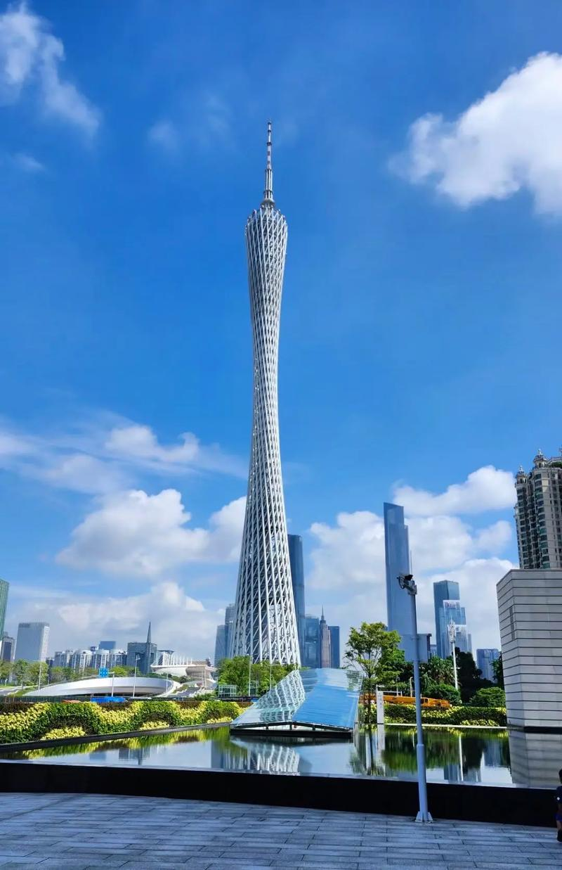
Definition and Importance of Fieldwork
01
What is Fieldwork?
Fieldwork is a qualitative research method used to study people and cultures in their natural environments. It involves direct observation, participation, and data collection. For example, anthropologists may live in a remote village to understand local customs and social structures.
Fieldwork is crucial in intercultural communication as it allows researchers to immerse themselves in different cultural contexts, observe behaviors, and gather authentic data. It helps reveal nuances in language use, social norms, and cultural practices that are often missed in other research methods.
02
Why Fieldwork Matters
Fieldwork provides firsthand insights into cultural practices and intercultural interactions. For instance, studying how different communities celebrate festivals in Guangzhou can reveal their values and traditions.
It enhances our understanding of cultural diversity and helps develop effective strategies for intercultural communication. By observing and participating in real- life situations, researchers can identify potential challenges and opportunities for cross- cultural interactions.

Slide 5
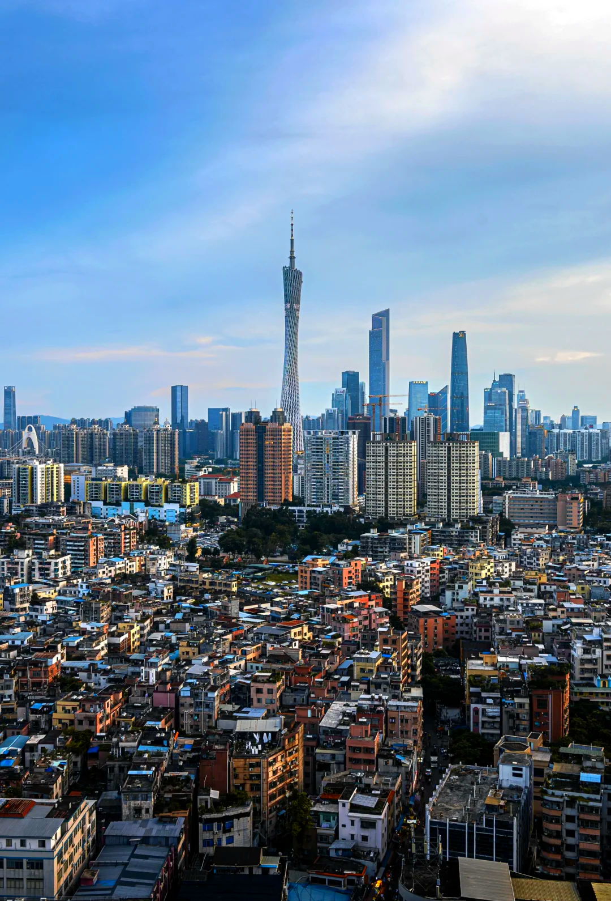
Overview of Fieldwork in Guangzhou
01.
Guangzhou as a Multicultural City
Guangzhou is a vibrant city with a rich history of trade, migration, and cultural exchange. It is home to diverse communities, including local Cantonese speakers, Mandarin- speaking migrants, and international expatriates. The city offers a unique setting for fieldwork, with a variety of cultural practices, languages, and social interactions.
02.
Key Themes for Fieldwork
Language and Communication: Guangzhou is a multilingual city where Cantonese, Mandarin, and English are used in different contexts. Fieldwork can explore how language choices affect intercultural interactions and social integration.
Cultural Practices: The city is known for its rich cultural heritage, including festivals like the Lunar New Year, traditional food markets, and religious sites such as the Temple of the Six Banyan Trees. These practices provide valuable insights into local identity and values.
Intercultural Interactions: Guangzhou’s diverse population offers numerous opportunities to study how locals and expatriates navigate cultural differences in daily life, from workplace interactions to social gatherings.

Slide 6
Fieldwork Methods
02

Slide 7
Participant Observation
Immersing in the Culture
Recording Observations
Participant observation involves actively engaging in the culture being studied. Researchers may participate in local events, join community activities, or even live among the community members. For example, attending a traditional Cantonese wedding can provide insights into family values and social norms.
This method allows researchers to gain a deeper understanding of cultural practices and behaviors from an insider’s perspective. It helps reveal subtle aspects of culture that may not be apparent through other methods.
During participant observation, researchers keep detailed field notes to record their observations, reflections, and insights. These notes capture the context, behaviors, and interactions witnessed in real- time.
For instance, observing a local market can reveal how vendors and customers communicate, negotiate prices, and use non- verbal cues. These observations can later be analyzed to understand cultural communication patterns.
+
+

Slide 8
Interviews
Conducting Structured and Unstructured Interviews
Capturing Insights
Interviews are a key fieldwork method where researchers conduct conversations with participants to gather information. Structured interviews follow a set of predetermined questions, while unstructured interviews allow for more open- ended discussions.
Interviewing a local resident about their experiences with intercultural interactions can provide valuable insights into the challenges and opportunities they face. Questions might include how they navigate cultural differences in daily life or what strategies they use to communicate effectively.
Interviews help capture personal stories, opinions, and experiences that enrich the understanding of intercultural communication. Participants can share their perspectives on cultural practices, language use, and social norms.
For instance, an expatriate living in Guangzhou might share how they adapt to the local culture, what cultural misunderstandings they encounter, and how they build relationships with locals. These insights can highlight common themes and unique experiences in intercultural interactions.

Slide 9
Field Notes
01
02
Documenting Observations and Reflections
Analyzing Field Notes
Field notes are an essential tool for recording observations, reflections, and insights during fieldwork. Researchers write detailed notes about the context, behaviors, and interactions they witness.
While observing a cultural festival, a researcher might note the types of performances, the audience’s reactions, and the cultural symbols used. These notes provide a rich source of data for later analysis.
Field notes are analyzed to identify patterns, themes, and insights. Researchers look for recurring behaviors, cultural practices, and communication strategies that emerge from their observations.
Analyzing field notes from a local market might reveal common language barriers, non- verbal communication cues, and social norms that influence intercultural interactions. These findings can inform the development of intercultural communication strategies.

Slide 10
03
Fieldwork Ethics

Slide 11
Respecting Privacy and Consent
Obtaining Informed Consent
Protecting Participant Privacy
Ethical fieldwork requires obtaining informed consent from participants. This means explaining the purpose of the research, how the data will be used, and ensuring participants agree to participate voluntarily.
Before conducting an interview, researchers should explain the research objectives, the confidentiality of the information, and how the data will be stored and shared. Participants should be given the option to withdraw at any time.
Researchers must protect the privacy of participants by keeping their identities confidential and using pseudonyms in reports. This ensures that sensitive information is not disclosed and participants are not identifiable.
When recording interviews or taking photographs, researchers should obtain explicit consent and ensure that the data is stored securely. This protects participants from potential harm or misuse of their information.

Slide 12
Cultural Sensitivity and Bias
Being Culturally Sensitive
Fieldwork requires researchers to be culturally sensitive and respectful of different cultural practices and beliefs. This involves being aware of cultural norms, avoiding stereotypes, and approaching the research with an open mind.
When studying a religious ceremony, researchers should observe and participate in a respectful manner, avoiding any actions that might be considered offensive or disrespectful. This helps build trust and ensures accurate and authentic data collection.
Avoiding Bias
Researchers must strive to avoid bias in their observations and interpretations. This involves recognizing their own cultural assumptions and being mindful of how these might influence their research.
When analyzing field notes, researchers should critically reflect on their own perspectives and consider multiple viewpoints. This helps ensure that the findings are objective and accurately represent the cultural context being studied.

Slide 13
04
In-Class Simulated Fieldwork Activities

Slide 14
Simulated Observation of Intercultural Interactions
Role-Playing Scenarios
Recording Simulated Observations
Students participate in role- playing scenarios that simulate intercultural interactions in Guangzhou. These scenarios can include interactions at a local market, a business meeting, or a social gathering.
Students can role- play a conversation between a local vendor and an international tourist, focusing on non- verbal communication, language use, and cultural symbols. This activity helps students practice observing and recording intercultural dynamics.
Students take detailed field notes during the role- playing scenarios, capturing the context, behaviors, and interactions. These notes will be used to analyze the simulated intercultural interactions.
Students note how participants adapt their communication styles, use gestures, and navigate cultural differences. This exercise helps develop skills in observation and data recording.

Slide 15

Simulated Mini-Interviews
Peer Interviews
Analyzing Interview Insights
Students conduct mini- interviews with their peers, focusing on intercultural experiences and communication strategies. Interview questions can be designed to explore challenges, successes, and insights.
Interview each other about their experiences with language barriers, cultural misunderstandings, and effective communication techniques. This activity helps students practice interview skills and gather qualitative data.
After conducting the mini- interviews, students summarize the key insights gained. This involves identifying common themes, challenges, and opportunities for intercultural interactions.
Discuss how cultural adaptability and patience contribute to successful intercultural communication. This analysis helps develop critical thinking and data interpretation skills.

Slide 16
Reflecting on Simulated Cultural Practices
Simulated Cultural Experiences
Writing Reflective Notes
Participate in simulated cultural experiences, such as a traditional tea ceremony or a mock cultural festival. These activities aim to replicate cultural practices and provide opportunities for reflection.
Students participate in a tea ceremony, observing and participating in the rituals and social interactions. This activity helps students understand cultural practices and their significance.
Write reflective notes on their simulated cultural experiences, focusing on how these practices reflect cultural identity and influence intercultural interactions.
Students reflect on how the tea ceremony highlights values of hospitality and respect. This reflection helps develop a deeper understanding of cultural practices and their role in intercultural communication.

Slide 17
Be prepared,
be humble,
be patient,
be nice!!!

